Slide 1

Md.Rafiqul Islam
ID:15101059

Slide 2
Agenda
Idea
Data Flow Diagram level 0
Data Flow Diagram level 1
Data Flow Diagram level 2

Slide 3

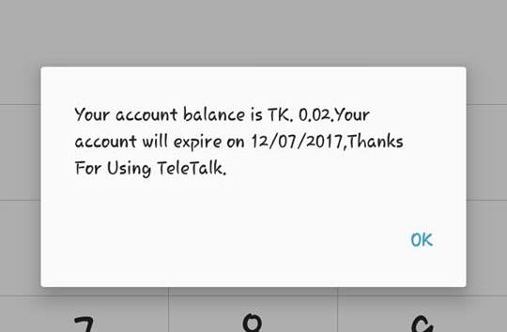
Idea

Slide 4

Data Flow Diagram level-0
Oder Delivery
Online site
Secure Gateway
Customers

Slide 5
Data Flow Diagram level-1
Receipt Deposit Cash
Validation Get Item
Authenticated Availability
Handover Request
Delivery Purchase
Accounts
PROCESS
User Information
Online Site
Order
Customer

Slide 6
Data Flow Diagram level-2
Receipt Deposit Cash
Validation Get Item
Authenticated Availability
Handover Request
Delivery Purchase
Accounts
PROCESS
User Information
Online Site
Order
Customer

Slide 7

Data Flow Diagram Level 2
Accounts Entity
Bill
Payment
Weekly & Monthly Consumption
Yearly Profit

Slide 8

Data Flow Diagram Level 2 (Accounts)
Accounts
Final Accounts
Check Payment
Verify
AccountProcess
Clearance
Transaction Table
Bill
Verified
Send
Payment Successful
Send
User

Slide 9
Data Flow Diagram Level 2
User Information Entity
Sign Up
Login/logout
Data Table
Match Email

Slide 10

DFD Level 2(User Information)
Order Store
Access
Entry
Store
Process
Check
Data Table
Email Address
Verify
Successfully done
Login/Logout
Email Address
User Sign Up

Slide 11
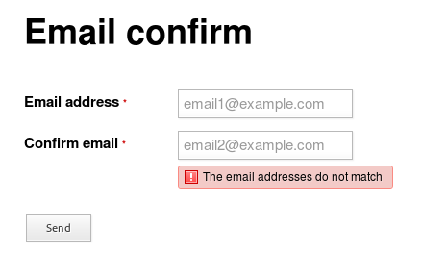

Security Check
Confirm Email address
Match with signed up ID

Slide 12
We make you sure you are always connected. Even if it’s the middle of the night or on weekends, we are have 24/7!

